Slide 1
Tuesday, October 25, 2016
Write In Your Agenda:
Write In Your Monitoring Log:
CW:
Finish Earthquake PPT and notes
Finish Earthquake Crossword and Word Search
HW:
None.
Response to Warm-Up:
Describe why/how earthquakes occur based on what you already know.
You will need:
Pencil
Earthquake Crossword and Word Search

Slide 2
Tuesday, October 25, 2016
Work with a partner.
Go to http://www.cusd80.com/Page/76352
Complete Earthquake Power Point note sheet.
Hand in when finished.
Work on Earthquake Crossword and Word Search. Use book pages 169-175, 178-179, 186-191 to help you!

Slide 3
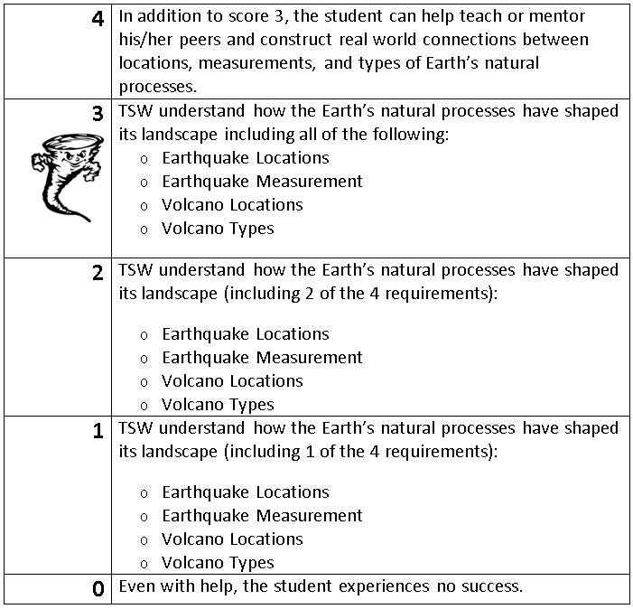
Learning Goal and Scale
TSW understand how the Earth’s natural processes have shaped its landscape (including Earthquake locations and how they are measured as well as Volcano locations and the three types).

